Slide 1
ETL Process Manager Financial Services
by Kenny Copas
Notes:
Checklist:
Waterbottle
Start Application
Drag VSCode to big screen
Start timer
Name
ETL Process Manager for a Financial Client
Background

Slide 2

Professional Summary
:)
Before Apprenticeship
Software Engineering (JavaScript, HTML, CSS, Java, Python)
Object-Oriented Programming, Dynamic Programming
During Apprenticeship
After Apprenticeship
Courses and Certifications
Data Engineering processes (ETL Processes, Data Analysis & Visualization)
Database Management, Data Security & Governance
Developing skillsets related to Data Engineering (Database Management, Data Processing)
Specialization in Data Structures and Algorithms
Agile Methodology
Kenny Copas
Data Engineer
PeopleShores PBC
Tampa, FL
linkedin.com/in/kennycopas
Notes:
2:00
Vscode should be on the main screen
Role, Company
Background (childhood, Software Engineer, DSA)
Current (Learning)
Future (Courses, Certifications, Learning as much as I can)
Problem

Slide 3




What problem is being solved?
Raw file data
Improperly Formatted
Local
Inaccessible
Accessible to Programmers
Non-visual
Difficult to Analyze
Not Presentable
Notes:
Control your speech tempo and affliction
A FINANCIAL SERVICES CLIENT
Client Need
Problems
Non-visual (Need to support a claim)
Lead into project overview

Slide 4
Project Overview
ETL Pipeline
Command Line Interface
Formats file data
Stores non-locally
Raw file data
Analysis & Visualization
User-friendly
Makes data accessible
Inaccessible
Tells a story
Makes data Presentable
Non-visual
Notes:
3:00
Lead from the problems being solved
Tell them what you’re going to tell them
Problem – Solution
Brief Explanation of Components
Tools being used

Slide 5




Tech Stack Overview
Database | Data Processing | Application | Visualization
Notes:
4:00
Very brief
Store data
Process Data
Application (Management)
Analysis & Visualization
How these tools interact (workflow)

Slide 6
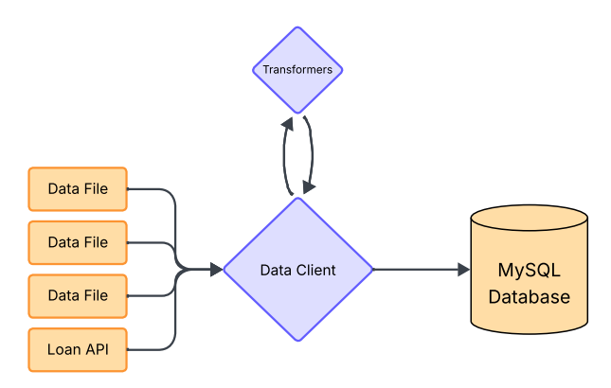
ETL Pipeline
Data Client
Manages ETL Process
Handles Database Queries
Transformers
Contains file-specific transformer functions
Handles transformer mapping
Transform
Extract
Load
Notes:
Data Client purpose (Modularity)
- Cybersecurity & Cloud
ETL Pipeline
Problem – Solution

Slide 7
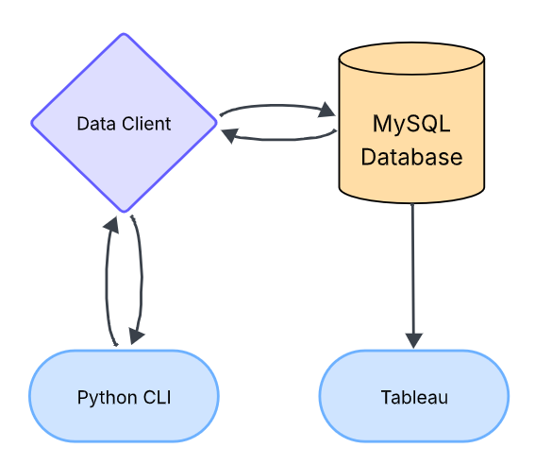
Command Line Interface
Query
Python CLI
User-friendly database interaction
Sends database queries to Data Client
Data Client
Handles database query requests from CLI
Sends database response to CLI
Data
Request
Response
Notes:
Python CLI
CLI -> Database through Data Client
Problem - Solution

Slide 8
Development Process
1. Data Migration Setup
2. Data Client
3. Command Line Interface
4. Application
Notes:
5:00
Showed the overview, now the steps to get there
Quick and Brief
Create Database
Database Connection and Interaction
User-friendly for non-technical
Full Application workflow

Slide 9
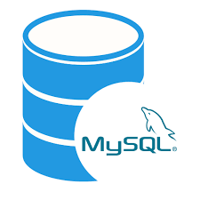
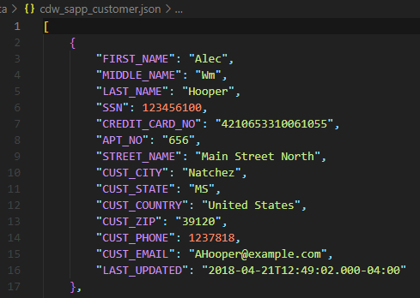
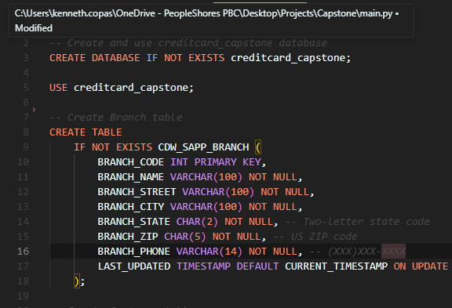
Data Migration Setup
MySQL - Database
cdw_sapp_customer.json - Data
init.sql - Script
MySQL – Database?
Unformatted
Unsorted
Cannot be loaded into database
Initializes Database
Creates Tables
Specifies Schema
Notes:
6:00
Tell them
Control speech tempo and dynamics
Raw Data
Database – Sike, create the database
How to get from point A to point B

Slide 10
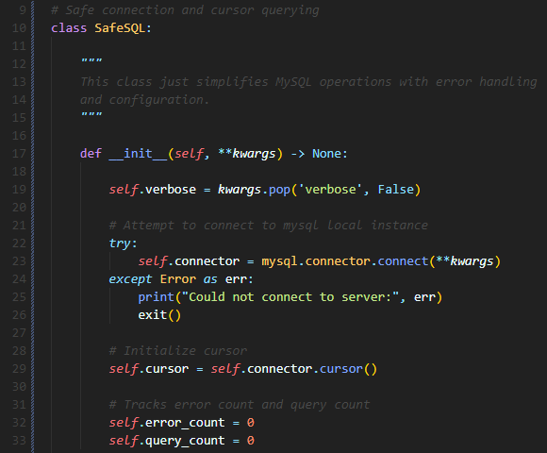
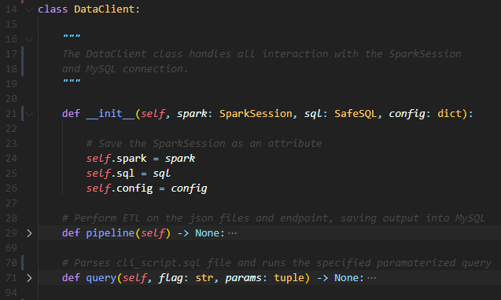
Data Client
sql.py - Utility
data_client.py - Component
General-Purpose
Database Interaction
Error Handling
Application-Specific
Manages ETL Process
Utilizes MySQL and PySpark connections
Notes:
7:00
Utility – Component interaction
Database connection (error handling)
Data Client uses sql for pipeline
Data is moved, how to access it

Slide 11
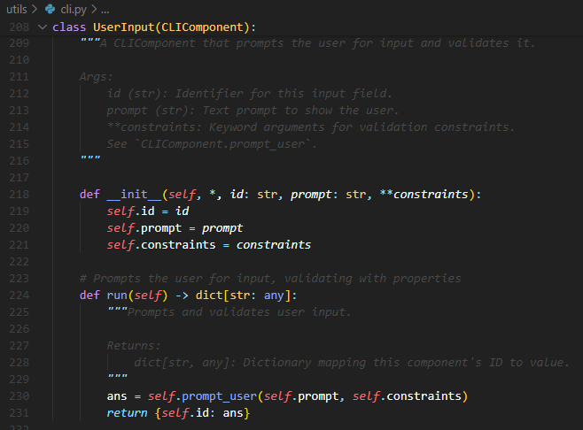
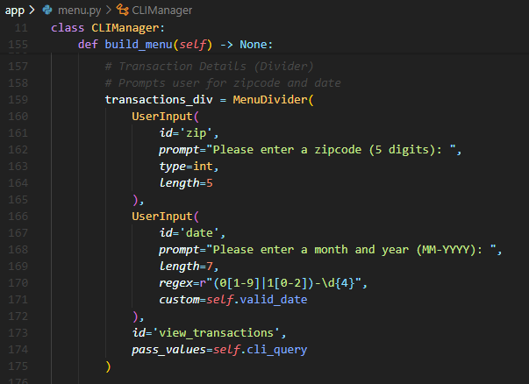
Command Line Interface
cli.py - Utility
menu.py - Component
General-Purpose
CLI Tool-Box
Simple
Application-Specific
User-friendly
Intuitive
Notes:
8:00
Build a CLI (menu), not without menu components
Use the menu components to make a menu
All components made, how to manage workflow

Slide 12
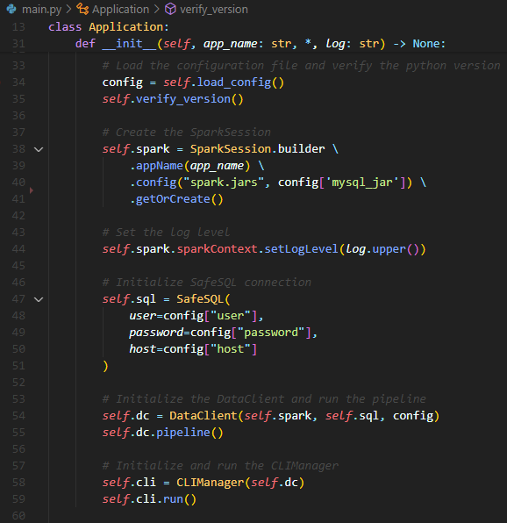
Application
Manager
main.py - Application
Loads Configurations
Initializes and Configures SparkSession (Connection to PySpark)
Creates SafeSQL Connection (Database Connector Utility)
Instantiates Data Client and runs ETL Pipeline
Instantiates and runs CLIManager
Notes:
9:00
Modularity = Brief Application
Application Workflow (In Order)
DEMO, show functionality
Lead How was this organized

Slide 13
Project Structure
main.py # Application requirements.txt # Required Libraries app ├── data_client.py # Data Client └── menu.py # CLI Menu Class config/ └── constants.py # Global Constants lib/ # MySQL Connector JDBC └── mysql-connector-j-9.3.0.jar data/ # JSON files ├── cdw_sapp_branch.json ├── cdw_sapp_credit_card.json └── cdw_sapp_customer.json | sql/ ├── cli_script.sql # CLI Query Scripts └── init.sql # Database Setup utils/ ├── cli.py # CLI Builder Class ├── transformers.py # Transformer Functions ├── logging.py # Logging Functions └── sql.py # MySQL Connector Class docs/ ├── CAP350_Project_Specs.pdf ├── diagrams/ # Workflow Diagrams └── mapping/ # Mapping PDFs
Notes:
10:00
Showed functionality, how did I organize it
Very brief
Save time for conclusion and Q&A
First two problems solved, lastly visualization

Slide 14
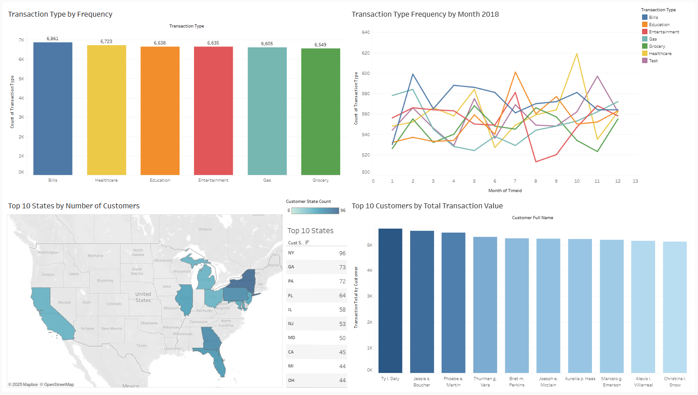
Notes:
Salesman: “Increase advertisement for education around august” Brief, save time for Q&A
Tableau Public Viz Link:
https://public.tableau.com/views/CustomerDataDashboard_17484417707510/CustomerDataDashboard?:language=en-US&:sid=&:redirect=auth&:display_count=n&:origin=viz_share_link

Slide 15







Thank you for your time!
github.com/kencopas/Capstone
Final Thoughts
This project manages an ETL Pipeline using PySpark and MySQL.
Kenny Copas
Data Engineer
PeopleShores PBC
Tampa, FL
The Command Line Interface provides non-technical users interaction with the database.
linkedin.com/in/kennycopas
Tableau is used for Data Analysis and Visualization to tell a story with the data.
Notes:
Tell them what you told them
Pipeline – Makes data clean non-local
CLI – Makes data easily accessible
Tableau – Enables story-telling and claims
Github + LinkedIn
Give time for Q&A

